Slide 1
Safe Platooning of Unmanned Aerial Vehicles via Reachability
Mo Chen, Qie Hu, Casey Mackin, Jaime Fisac,
Shankar Sastry, Claire Tomlin
2015-03-19 NASA UTM Meeting

Slide 2
Goals
Tractable analysis of N quadrotors by restricting them into a single-file platoon
HJ reachability
Liveness controllers
Safety controllers
Simulations

Slide 3
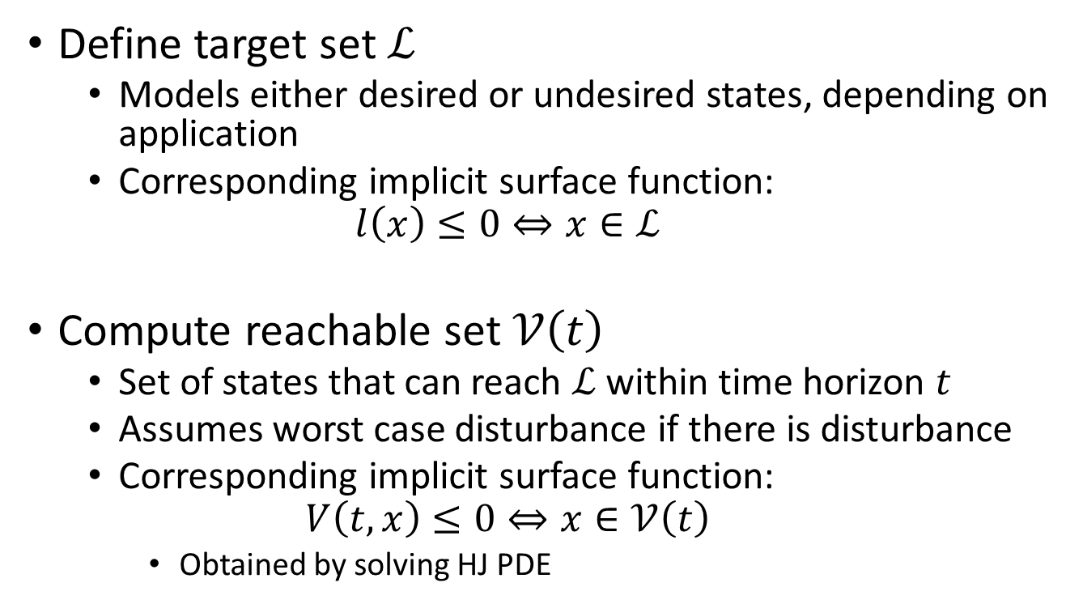
HJ Reachability
Define target set
Models either desired or undesired states, depending on application
Corresponding implicit surface function:
Compute reachable set
Set of states that can reach within time horizon
Assumes worst case disturbance if there is disturbance
Corresponding implicit surface function:
Obtained by solving HJ PDE

Slide 4
Liveness controllers from reachable sets
Merging onto a highway
Target set: desired merging point and relative velocity
Reachable set: set of states that can reach target set
Joining platoon on highway
Target set: desired merging point in terms of relative coordinates
Reachable set: set of states in relative coordinates that can reach target set
Controller
Take straight line towards target until vehicle is inside reachable set
Use optimal control from reachable set once vehicle is inside reachable set

Slide 5
Safety controllers
Collision avoidance
Target set: collision box in relative states plus (union) velocity limits
Reachable set: set of states in relative coordinates that will hit target set assuming worst case disturbance
Controller
Use liveness controller if safe
Use safety controller if not safe

Slide 6
Merging onto highway
Notes:
LEFT: red quadrotor merges onto highway at red circle: straight line towards target when outside of reachable set (red dotted boundary), and then optimal controller from reachable set once inside.
Blue quadrotor joins platoon behind red; straight line to blue circle (defined in the relative state) when not inside reachable set, optimal control when inside.
Must stay outside of safety reachable set at all times (dashed boundaries)
RIGHT: The first quadrotor that completes the merging onto an empty highway creates a platoon and becomes its leader, while subsequent quadrotors form a platoon behind the leader in a pre-specified order.

Slide 7
Responding to intruder
Notes:
Within platoon, safety breached if there could be a collision within next 1.5 seconds.
W.r.t to the intruder, safety is breached if there could be a collision within next 3 seconds.

Slide 8
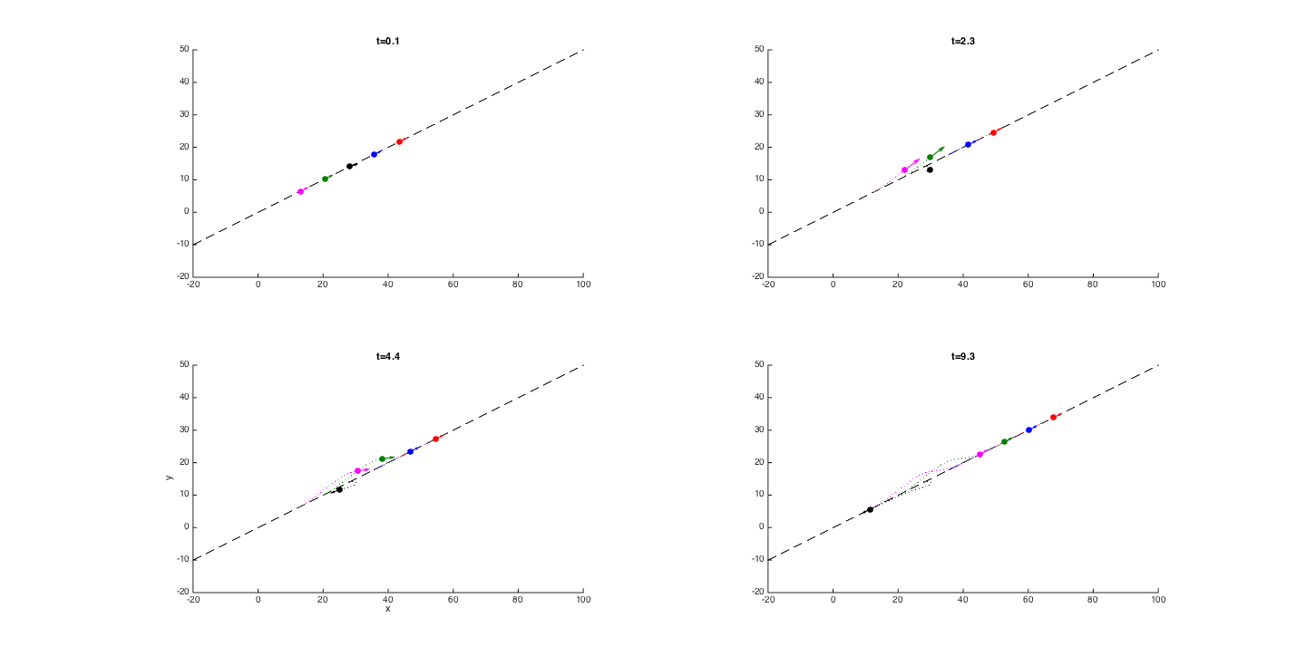
Faulty quad-rotor in platoon

Slide 9
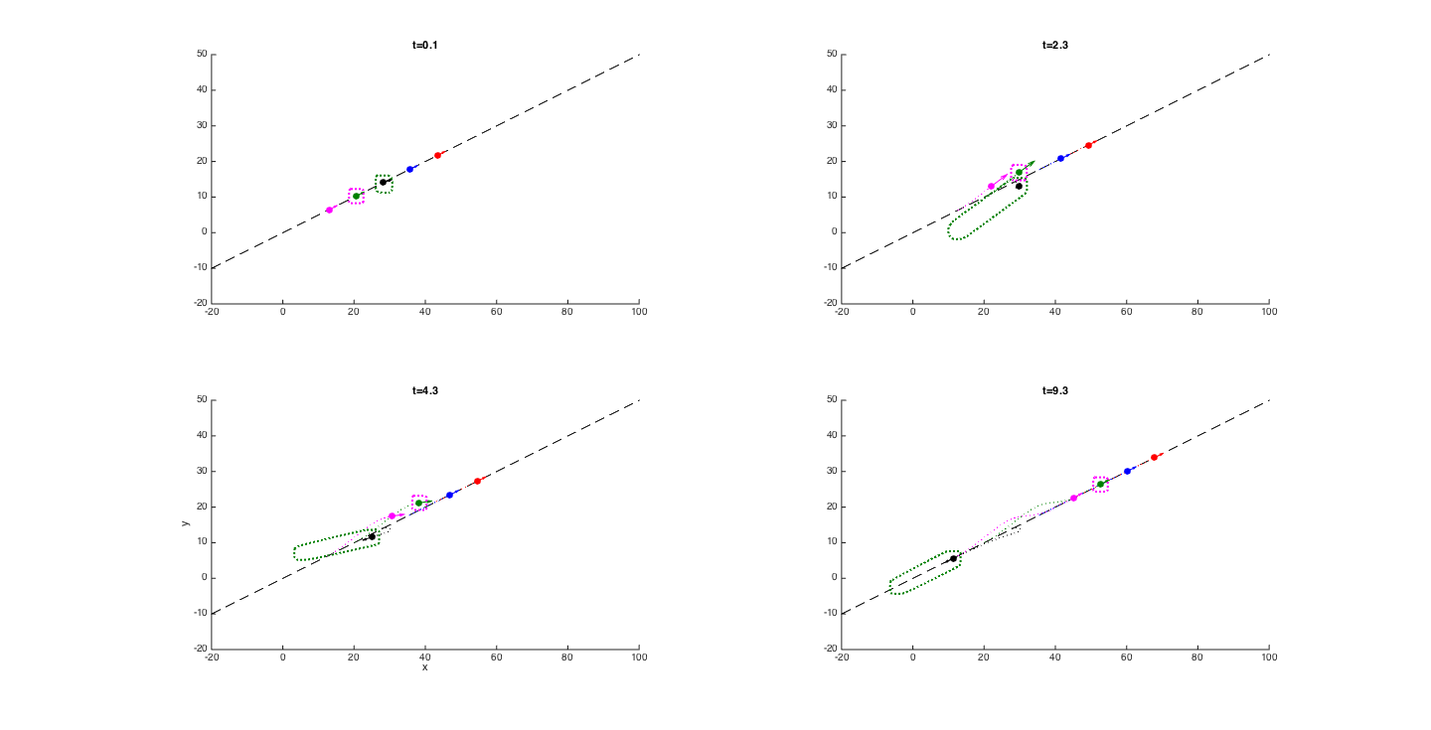
Faulty quad-rotor in platoon w/ RS

Slide 10
Dynamics
Single quadrotor dynamics
Relative coordinates
Notes:
i is evader, j is pursuer

Slide 11
Dynamics
Relative dynamics (for collision avoidance)
Augmented relative dynamics (for collision avoidance and velocity limit)
Notes:
Velocity of quadrotor i needed for specifying velocity limit

Slide 12
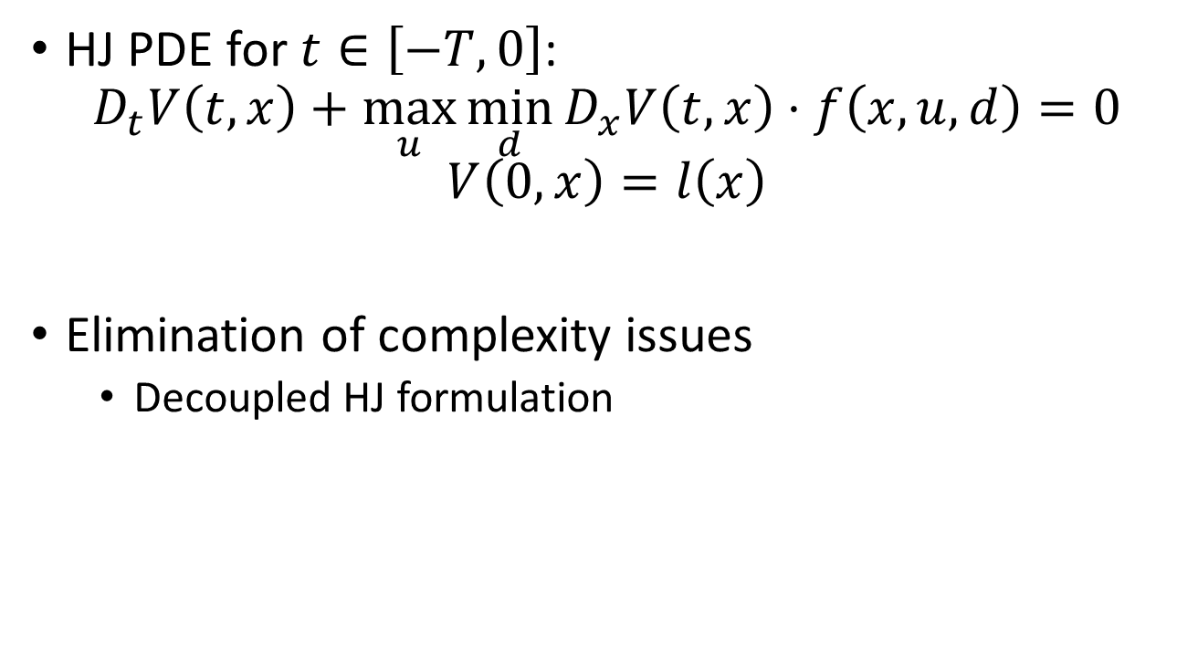
HJ Reachability
HJ PDE for $t∈\left[−T,0\right]$:
$$D_{t}V\left(t,x\right)+\max_{u}{\min_{d}{D_{x}V\left(t,x\right)⋅f\left(x,u,d\right)}}=0$$
$$V\left(0,x\right)=l\left(x\right)$$
Elimination of complexity issues
Decoupled HJ formulation

